Slide 1
Shielding Effect among Grounding Conductors
A grounding device usually consists of a group of grounding conductors and, when the current diffuses into soil through one conductor, it is affected by the other conductors.
Adding more horizontal conductors to a grounding grid, or adding short vertical rods to a grounding grid, can only reduce the grounding resistance by a little and this is because the internal conductors of the grounding grid are shielded by the peripheral conductors.
same speaking, it is only when the distance between two conductors is infinite that the electric field generated by one grounding conductor is not affected by the other one.

Slide 2
Considering this shielding effect, the grounding resistance of the grounding device is not equal to the parallel value of the grounding resistances of all the grounding conductors. Different grounding conductors of a grounding device diffuse currents with the same polarity into soil, so we can use two adjacent point sources (as shown in Figure 8) to analyze the interaction between them.
Both point sources inject the same current I into the earth at the same time, but the current lines do not radiate around as a single point source does,
because the current diffusing from source A cannot disperse to the right side of the vertical plane ON perpendicular to the midpoint of AB connecting line, and the current diffusing from point source B cannot disperse to the left side of the plane ON.

Slide 3
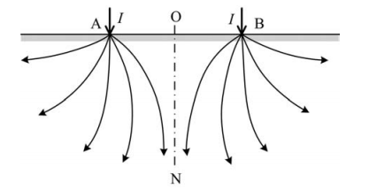
Figure 8 Shielding effect between two neighboring point sources with the same polarity.
The plane ON is like a shielding layer preventing the current from getting through.

Slide 4
This phenomenon is called the shielding effect between grounding conductors.
Because of the shielding effect among grounding conductors, the current diffusing area is much smaller than that of one grounding conductor, and the corresponding grounding resistance of one grounding conductor is larger than that of one grounding conductor.
From Figure 8 we can ascertain that, when the current from a point current source passes through the cross-section, there is an increase in the resistance encountered during current diffusion, and this resistance is called the current dispersing resistance.

Slide 5
Usually the mutual resistance between two grounding conductors is used to represent the interaction between them, which means that a potential is generated on conductor B without a current applied when grounding conductor A diffuses unit current into the soil, while the potential generated on grounding conductor A itself is called self-resistance, the potentials of n grounding conductors can be expressed as:

Slide 6
where V₁, V₂, . . . , V_{n} are the potentials of all conductors, I₁, I₂, . . . , I_{n} are the corresponding currents through them and R_{ii} and R_{ki} are the self-resistance of grounding conductor i and the mutual resistance between conductors i and k.

Slide 7
When a current I diffuses into the soil through two adjacent conductors, the corresponding potential equations are:

Slide 8
The two conductors are connected to each other, so they have the same potential V=V1=V2 , I=I1+I2 and R12=R21. Substituting these conditions in Equation above, the grounding resistance of the complex grounding device constituted by two adjacent conductors is:

Slide 9
Obviously, the grounding resistance of the complex grounding device is not equal to the parallel resistance of the two self-resistances:
The grounding resistance R of the complex grounding device is bigger than the parallel value of self-resistances.
As a result of the existence of the mutual resistance generated by the shielding effect, the grounding resistance of a grounding device increases.

Slide 10
In engineering, the usage coefficient is usually used to represent the shielding effect among conductors of a grounding device, which is defined as:
and is always less than 1.0

Slide 11
Grounding Resistance of Simple Grounding Devices

Slide 13
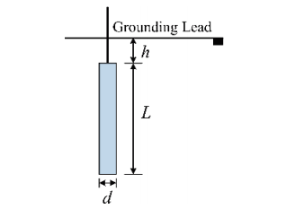
A vertical ground rod with burial depth h is shown in Figure
Figure 9 Vertical ground rod with burial depth h.
and its grounding resistance can be calculated by the following two formulas :

Slide 14
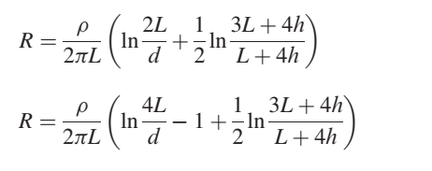
If the horizontal round ground rod is buried on the ground surface, the calculation formula for its grounding resistance based on the average potential method is:

Slide 15
A horizontal grounding plate is shown in Figure . Generally, its length L is far longer than its width a and thickness t. The thickness t is less than one-eighth of the width a, and the burial depth h ˂ L. The formula for calculating the grounding resistance of the horizontal grounding electrode has the following.

Slide 16
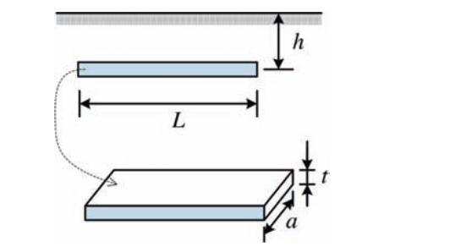
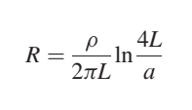
Figure . Diagram of horizontal grounding plate

Slide 17
Body Safety and Permitted Potential Difference Allowable Body Current Limit
An electric shock accident is usually determined by the frequency, magnitude and duration of the current passing through the vital part of a human (this generally refers to the heart). When a current passes through the heart it causes ventricular fibrillation.
Generally, the minimum current a human can feel is about 1 mA, and the stimulation of a human body caused by a current of 9–25 mA is rather painful. It may make muscles lose control and it may be difficult or impossible to unclamp a charged object held in the hand.

Slide 18
When the current becomes greater, heart fibrillation occurs and causes death. Therefore, the critical value of an electric shock current causing ventricular fibrillation is the main issue to be considered in the safety design of a grounding device. For an AC current with a frequency of 50 Hz, it can be classified into three categories according to human responses:

Slide 19
Sensory current: this is the minimum current a human can feel. For a male adult it is 1.1 mA, and for a female adult it is 0.7 mA.
Extrication current: this is the maximum current that can be extricated by human after electroshock. It is also related to gender, for a male adult it is 16 mA and for a female adult it is 10.5 mA.
Fatal current: this is the minimum current that threatens life in the shortest time, by causing ventricular fibrillation.

Slide 20
The value of the current plays a vital role in electroshock on the human body. However, when current passing through the body, the duration of the current must also be considered. According to analysis, if the duration is very short, the current that a human can tolerate and which does not cause ventricular fibrillation is:
where the unit of is A; and K is an energy coefficient related to the weight of the human body.

Slide 21
The energy coefficients of 50 and 70 kg humans are K₅₀ = 0.0135 and K₇₀ =0.0247 , respectively. Therefore, we can get the allowable body current I_{K50} for a 50 kg human :
According to the calculation result from Equation above, the permitted current corresponding to 1 s duration is 116 mA, while that corresponding to 0.1 s is 367 mA and that corresponding to 0.05 s is 519 mA.

Slide 22
The allowable body current I_{K70} for a 70 kg human is

Slide 23
Allowable Body Voltage
Multiplying the allowable body current I_{K} by the body resistance R_{B}, we can obtain the allowable body voltage U_{SV}:
In a solidly grounded system, a single-phase or two-phase ground fault cannot exist for a long time, so substituting Equation current into voltage Equation, the short-time allowable body voltage for a 50 kg human is:

Slide 24
Also the allowable body voltage for a 70 kg human can be obtained:
If we assume the body resistance R_{B} =1000 V and t = 1 s, the allowable body voltage in 1 s for 50 and 70 kg humans are 116 and 157 V, respectively.

Slide 25
Allowable Potential Difference
The allowable potential difference of a human body involves the touch voltage, step voltage . The step voltage is the difference in surface potential experienced by a person bridging a distance of 1 m with his two feet without contacting any other grounded object, whereas the touch voltage is the potential difference between the ground potential rise (GPR) and the surface potential at the point where a person is standing, while at the same time his hand is in contact with a grounded object.

Slide 26
After obtaining the allowable body current by Equations above, when the appropriate parameters of the human body are determined, we can calculate the allowable potential difference generated between the contact points.

Slide 27
the external current may have two parallel paths: one is the direct path through the earth, the other is through the external parallel circuit.
Because the fault current is as high as several hundred to several thousand amperes, while the allowable body current must be limited to a milli ampere level, the influence of the body on the applied voltage can be neglected.
We can assume that all the potential differences before the electroshock are not changed.

Slide 28
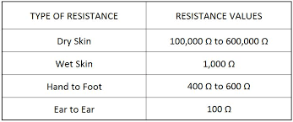

Slide 29
When one walks on the ground, the touch resistance R_{F} between the two feet and the ground surface and the body resistance R_{B} are connected in series, and the permissible step voltage U_{S} between the two feet is:
where Vs is the potential difference between two points where no person stands.

Slide 30
When a person stands on the ground and contacts any grounded metal conductor, the touch resistances between the two feet and the ground are in parallel, and the actual voltage (i.e., the permissible touch voltage U_{T}) between one hand and one foot is:
where VT is the potential difference between two points where no person stands.

Slide 31
When the feet are in contact with the ground, the touch resistance R_{F} between one foot and the ground surface has a strong influence on the body current. Usually, one foot is regarded as a round plate with radius b (in cm) and then, in uniform soil, R_{F} can be calculated by:
If the resistivity of the surface soil is assumed as 200 Ωm, the body resistance as 1000 Ω, Usually, one foot is regarded as a round plate with radius b (in cm) , IF b=8

Slide 32
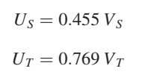
the step voltage U_{S} and the touch voltage U_{T} calculated by Equations above are:

Slide 33
if R_{F} = 3

Slide 34
